Slide 1
重要觀念圖

Slide 2
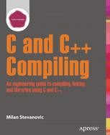
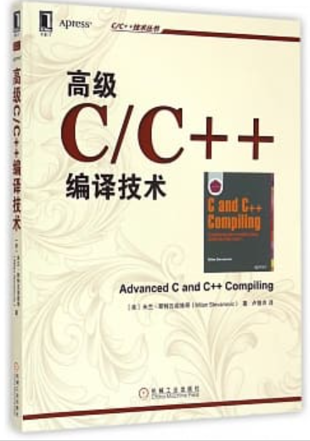
2014 Advanced C and C++ Compiling Authors: Stevanovic, Milan
https://www.apress.com/gp/book/9781430266679

Slide 3
Chapter 1
Multitasking OS Basics

Slide 4
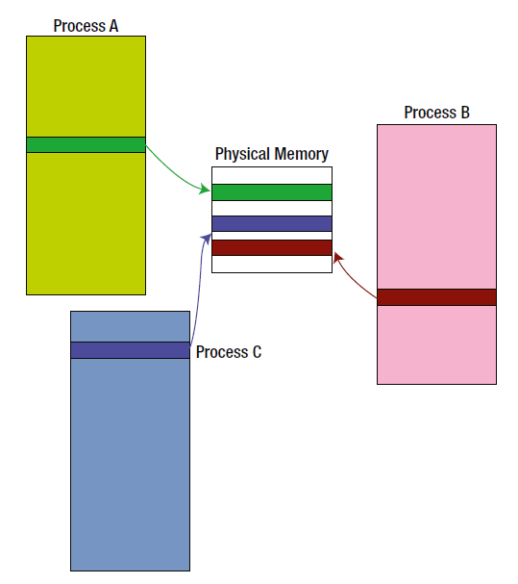

Slide 5
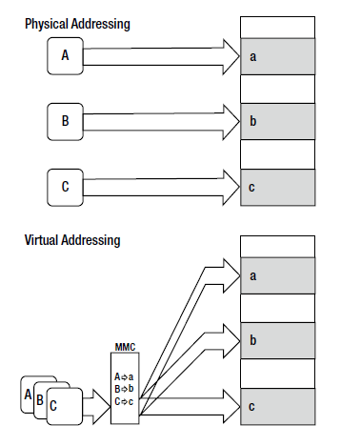

Slide 6
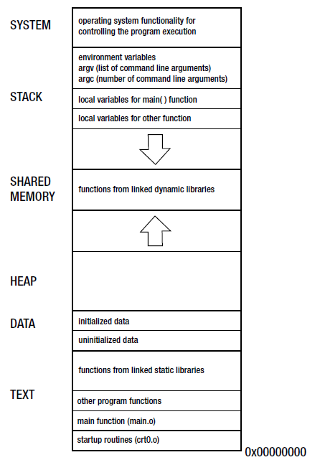
Process Memory Division Scheme

Slide 7
Chapter 2
Simple Program Lifetime Stages

Slide 8
gcc -S -masm=att function.c -o function.s
gcc -S -masm=intel function.c -o function.s

Slide 9
objdump -D <input file>.o
objdump -D -M intel <input file>.o

Slide 10
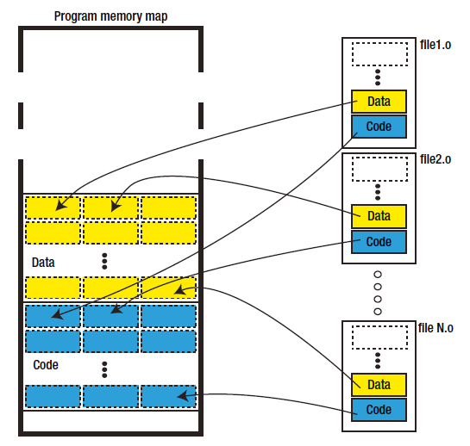
Figure 2-3. Tiling the individual sections into the final program memory map

Slide 11
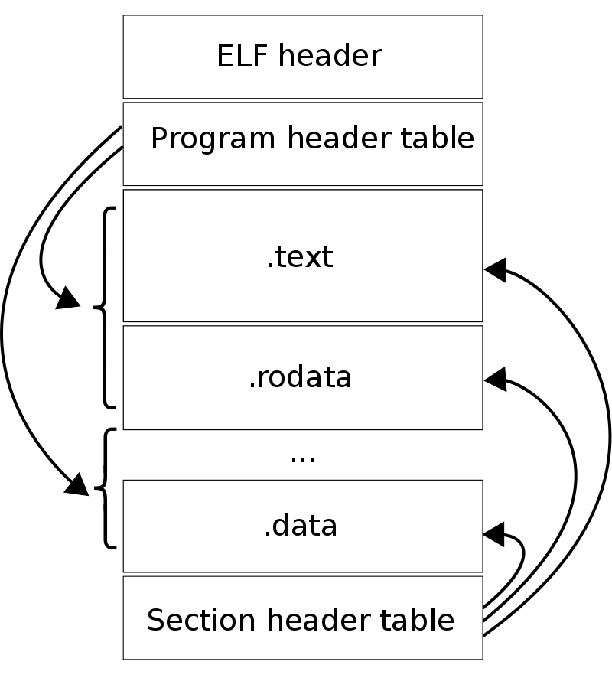
https://en.wikipedia.org/wiki/Executable_and_Linkable_Format
An ELF file has two views:
the program header shows the segments used at run time,
whereas the section header lists the set of sections of the binary.
https://man7.org/linux/man-pages/man5/elf.5.html

Slide 12
Chapter 3
Program Execution Stages

Slide 13
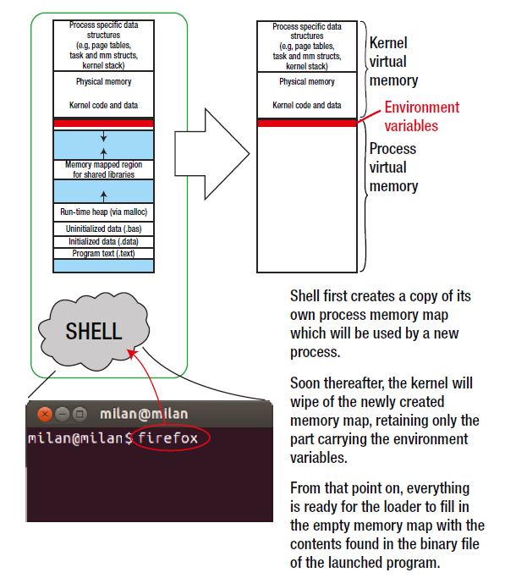

Slide 14
